Slide 1
[图灵完备×计组] ——
基于《图灵完备》的32位MIPS架构单周期CPU的设计与实现
系列视频
10 控制逻辑补充
2024/07/04
2022113573@stu.hit.edu.cn

Slide 2
[5]
0
控制逻辑
a₁
1
[5:0]
a₀
[4]
2
op
3
[3:0]
为0001？
全为0？
为0000？
[5]
0001
1010
[4]
[5:0]
为010000？
func
[3:0]
移位？
RegBranch
RegWrite
AluOp
Shift
Imm
MemRead
MemWrite
NearBranch
AbsBranch

Slide 3
add
sub
and
or
xor
slt
seq
sgt
sll
srl
sra
jr ......
RegBranch
NearBranch
AbsBranch
AluOp
RegWrite
MemRead
MemWrite
Shift
Imm
op
①
②
func

Slide 4
类型 | 助记符 | op
I型 | addi | 000001
 | subi | 000010
 | andi | 000011
 | ori | 000100
 | xori | 000101
 | slti | 001001
 | seqi | 001010
 | sgti | 001011
 | slli* | 000110
 | srli* | 000111
 | srai* | 001000
 | lw | 010000
 | sw | 010001
 | beq | 100000
类型 | 助记符 | op | func
R型 | add | 000000 | 000001
 | sub |  | 000010
 | and |  | 000011
 | or |  | 000100
 | xor |  | 000101
 | slt |  | 001001
 | seq |  | 001010
 | sgt |  | 001011
 | sll |  | 000110
 | srl |  | 000111
 | sra |  | 001000
 | jr |  | 010000
类型 | 助记符 | op
J型 | j | 100001

Slide 5
1
EN
000000
000001
000010
000011
000100
000101
001001
001010
001011
000110
000111
001000
010000
010001
100000
100001
EN
000001
000010
000011
000100
000101
001001
001010
001011
000110
000111
001000
010000
add
sub
and
or
xor
slt
seq
sgt
sll
srl
sra
jr
addi
subi
andi
ori
xori
slti
seqi
sgti
slli
srli
srai
lw
sw
beq
j
[5]
a5
[5]
a5
a4
a4
op
a3
func
a3
a2
a2
a1
a1
a0
a0
[0]
[0]
6-64
译码器
6-64
译码器

Slide 6
控制信号 | add | sub | and | or | xor | slt | seq | sgt | sll | srl | sra | jr | addi | subi | andi | ori | xori | slti | seqi | sgti | slli | srli | srai | lw | sw | beq | j
RegBranch |  |  |  |  |  |  |  |  |  |  |  | 1
NearBranch |  |  |  |  |  |  |  |  |  |  |  |  |  |  |  |  |  |  |  |  |  |  |  |  |  | 1
AbsBranch |  |  |  |  |  |  |  |  |  |  |  |  |  |  |  |  |  |  |  |  |  |  |  |  |  |  | 1
Aluop | func [3:0] |  |  |  |  |  |  |  |  |  |  |  | op [3:0] |  |  |  |  |  |  |  |  |  |  | 0001 | 0001 | 1010
RegWrite | 1 | 1 | 1 | 1 | 1 | 1 | 1 | 1 | 1 | 1 | 1 |  | 1 | 1 | 1 | 1 | 1 | 1 | 1 | 1 | 1 | 1 | 1 | 1
MemRead |  |  |  |  |  |  |  |  |  |  |  |  |  |  |  |  |  |  |  |  |  |  |  | 1
MemWrite |  |  |  |  |  |  |  |  |  |  |  |  |  |  |  |  |  |  |  |  |  |  |  |  | 1
Shift |  |  |  |  |  |  |  |  | 1 | 1 | 1
Imm |  |  |  |  |  |  |  |  |  |  |  |  | 1 | 1 | 1 | 1 | 1 | 1 | 1 | 1 | 1 | 1 | 1 | 1 | 1
p.s. 无值即表示0

Slide 7
xor | 按位异或 | rd ← rs ^ rt
控制信号 | add | sub | and | or | xor | slt | seq | sgt | sll | srl | sra | jr | addi | subi | andi | ori | xori | slti | seqi | sgti | slli | srli | srai | lw | sw | beq | j
RegBranch |  |  |  |  |  |  |  |  |  |  |  | 1
NearBranch |  |  |  |  |  |  |  |  |  |  |  |  |  |  |  |  |  |  |  |  |  |  |  |  |  | 1
AbsBranch |  |  |  |  |  |  |  |  |  |  |  |  |  |  |  |  |  |  |  |  |  |  |  |  |  |  | 1
Aluop | func [3:0] |  |  |  |  |  |  |  |  |  |  |  | op [3:0] |  |  |  |  |  |  |  |  |  |  | 0001 | 0001 | 1010
RegWrite | 1 | 1 | 1 | 1 | 1 | 1 | 1 | 1 | 1 | 1 | 1 |  | 1 | 1 | 1 | 1 | 1 | 1 | 1 | 1 | 1 | 1 | 1 | 1
MemRead |  |  |  |  |  |  |  |  |  |  |  |  |  |  |  |  |  |  |  |  |  |  |  | 1
MemWrite |  |  |  |  |  |  |  |  |  |  |  |  |  |  |  |  |  |  |  |  |  |  |  |  | 1
Shift |  |  |  |  |  |  |  |  | 1 | 1 | 1
Imm |  |  |  |  |  |  |  |  |  |  |  |  | 1 | 1 | 1 | 1 | 1 | 1 | 1 | 1 | 1 | 1 | 1 | 1 | 1
p.s. 无值即表示0

Slide 8
lw | 读内存单元 | rt ← mem[rs + (sign-extend) imm]
控制信号 | add | sub | and | or | xor | slt | seq | sgt | sll | srl | sra | jr | addi | subi | andi | ori | xori | slti | seqi | sgti | slli | srli | srai | lw | sw | beq | j
RegBranch |  |  |  |  |  |  |  |  |  |  |  | 1
NearBranch |  |  |  |  |  |  |  |  |  |  |  |  |  |  |  |  |  |  |  |  |  |  |  |  |  | 1
AbsBranch |  |  |  |  |  |  |  |  |  |  |  |  |  |  |  |  |  |  |  |  |  |  |  |  |  |  | 1
Aluop | func [3:0] |  |  |  |  |  |  |  |  |  |  |  | op [3:0] |  |  |  |  |  |  |  |  |  |  | 0001 | 0001 | 1010
RegWrite | 1 | 1 | 1 | 1 | 1 | 1 | 1 | 1 | 1 | 1 | 1 |  | 1 | 1 | 1 | 1 | 1 | 1 | 1 | 1 | 1 | 1 | 1 | 1
MemRead |  |  |  |  |  |  |  |  |  |  |  |  |  |  |  |  |  |  |  |  |  |  |  | 1
MemWrite |  |  |  |  |  |  |  |  |  |  |  |  |  |  |  |  |  |  |  |  |  |  |  |  | 1
Shift |  |  |  |  |  |  |  |  | 1 | 1 | 1
Imm |  |  |  |  |  |  |  |  |  |  |  |  | 1 | 1 | 1 | 1 | 1 | 1 | 1 | 1 | 1 | 1 | 1 | 1 | 1
p.s. 无值即表示0

Slide 9
控制信号 | 表达式
RegBranch | jr
NearBranch | beq
AbsBranch | j
AluOp | (add+sub+and+or+xor+slt+seq+sgt+sll+srl+sra)*func[3:0]+ (addi+subi+andi+ori+xori+slti+seqi+sgti+slli+srli+srai)*op[3:0]+ (lw+sw)*0001+beq*1010
RegWrite | add+sub+and+or+xor+slt+seq+sgt+sll+srl+sra+ addi+subi+andi+ori+xori+slti+seqi+sgti+slli+srli+srai+ lw
MemRead | lw
MemWrite | sw
Shift | sll+srl+sra
Imm | addi+subi+andi+ori+xori+slti+seqi+sgti+slli+srli+srai+ lw+sw

Slide 10
add
sub
and
or
xor
slt
seq
sgt
sll
srl
sra
jr
addi
subi
andi
ori
xori
slti
seqi
sgti
slli
srli
srai
lw
sw
beq
j
≥1
RegWrite
func[3:0]
op[3:0]
AluOp
0001
1010
≥1
RegBranch
Imm
sll
srl
sra
Shift
MemRead
MemWrite
NearBranch
AbsBranch

Slide 11
add
sub
and
or
xor
slt
seq
sgt
sll
srl
sra
jr
addi
subi
andi
ori
xori
slti
seqi
sgti
slli
srli
srai
lw
sw
beq
j
&
RegWrite
func[3:0]
op[3:0]
AluOp
0001
1010
&
RegBranch
Imm
sll
srl
sra
Shift
MemRead
MemWrite
NearBranch
AbsBranch

Slide 12
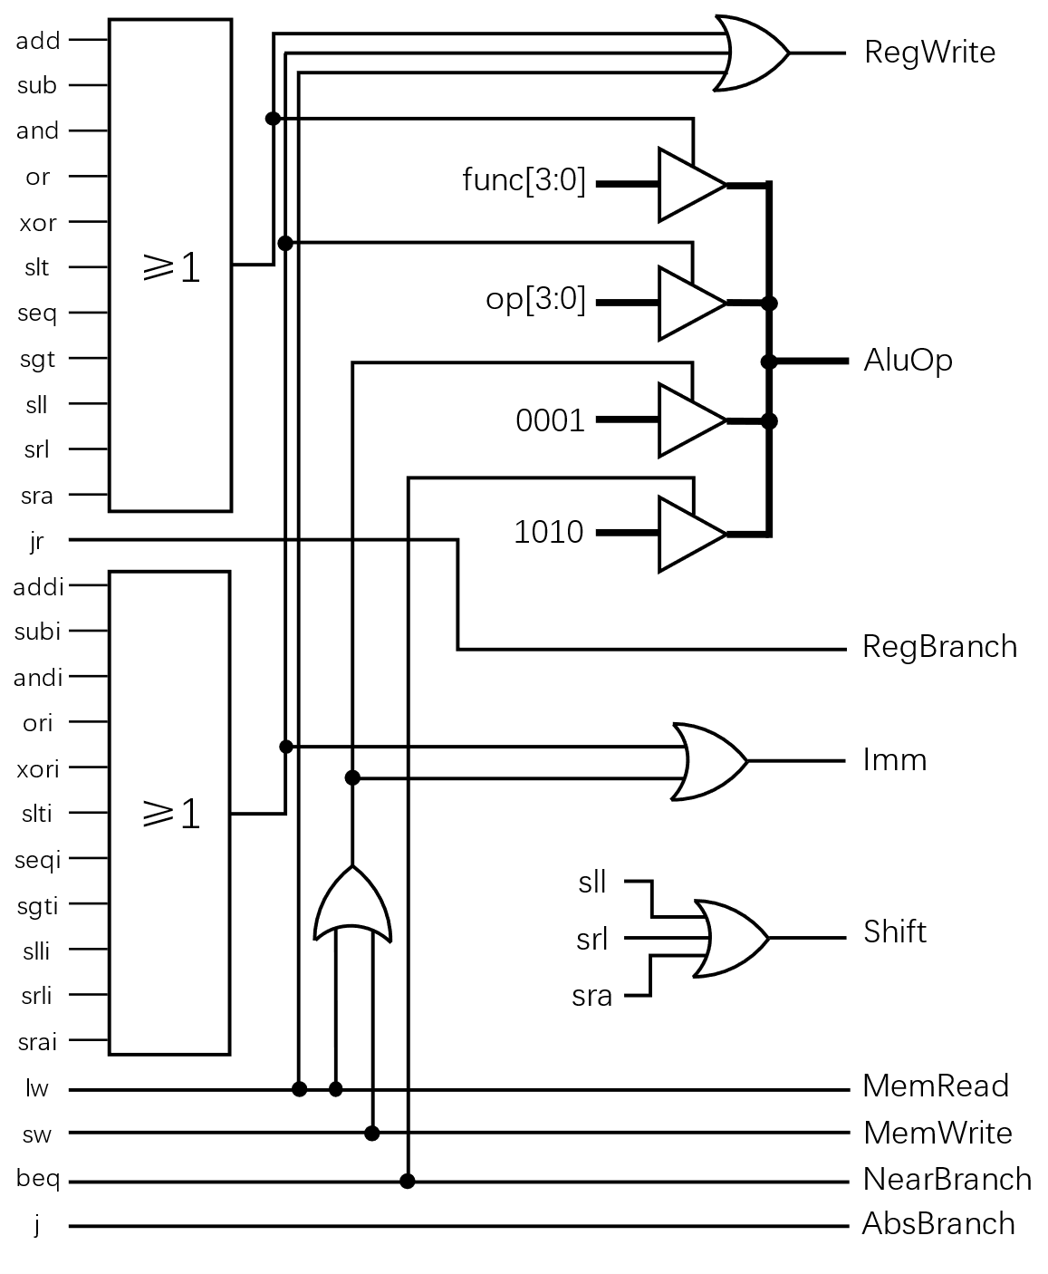
控制信号 | 表达式
RegBranch | jr
NearBranch | beq
AbsBranch | j
AluOp | (add+sub+and+or+xor+slt+seq+sgt+sll+srl+sra)*func[3:0]+ (addi+subi+andi+ori+xori+slti+seqi+sgti+slli+srli+srai)*op[3:0]+ (lw+sw)*0001+beq*1010
RegWrite | add+sub+and+or+xor+slt+seq+sgt+sll+srl+sra+ addi+subi+andi+ori+xori+slti+seqi+sgti+slli+srli+srai+ lw
MemRead | lw
MemWrite | sw
Shift | sll+srl+sra
Imm | addi+subi+andi+ori+xori+slti+seqi+sgti+slli+srli+srai+ lw+sw

Slide 13
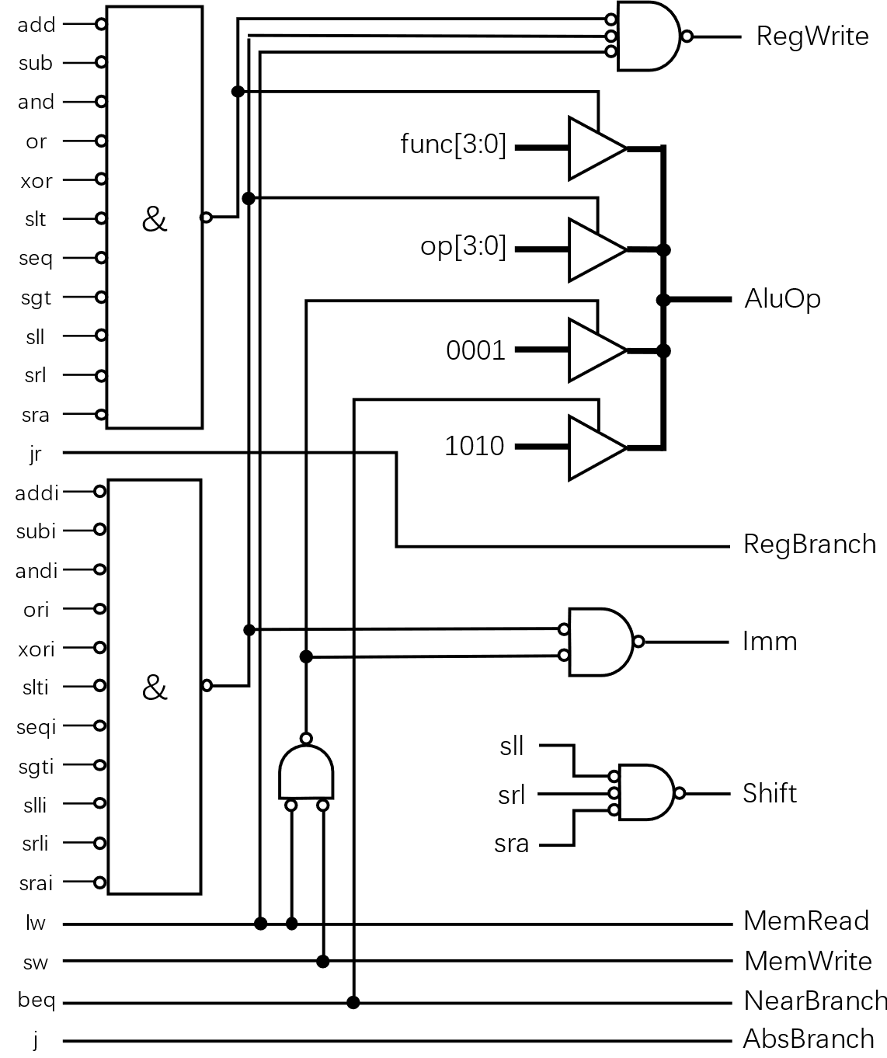
控制信号 | 表达式
RegBranch | jr
NearBranch | beq
AbsBranch | j
AluOp | (add+sub+and+or+xor+slt+seq+sgt+sll+srl+sra)*func[3:0]+ (addi+subi+andi+ori+xori+slti+seqi+sgti+slli+srli+srai)*op[3:0]+ (lw+sw)*0001+beq*1010
RegWrite | add+sub+and+or+xor+slt+seq+sgt+sll+srl+sra+ addi+subi+andi+ori+xori+slti+seqi+sgti+slli+srli+srai+ lw
MemRead | lw
MemWrite | sw
Shift | sll+srl+sra
Imm | addi+subi+andi+ori+xori+slti+seqi+sgti+slli+srli+srai+ lw+sw

Slide 14
[图灵完备×计组] ——
基于《图灵完备》的32位MIPS架构单周期CPU的设计与实现
系列视频
10 控制逻辑补充
End
2022113573@stu.hit.edu.cn

